Slide 1
Probabilistic Thresholding for Graph Signal Processing
Prospectus
Capt Jeffrey Williams
22 Feb 2021

Slide 2
Overview
Motivation
Background
Graph Signal Processing
Current Wavelet Transform Methods
Proposed Methodology
Case Study 1: Minnesota Street Map
Case Study 2: Dendritic Tree (Rat Brain Cell Widths)
Proposed Research
Case Study 3: Denoising 3D manifolds
Case Study 4: City of Toronto Data
Case Study 5: New application (Pandemic)
Case Study 6: Military application (Battle Damage Assessment)

Slide 3
Motivation
Technological advancements have made automatic data collection more prominent. The topography and structure of data are becoming a larger part of data analysis.
Data Topography is traditionally studied using graph theory, where the topography of data is represented as a series of nodes and edges. This is a new frontier for signal processing tools
Graph signal processing fills technical gap between signal processing and graph theory.

Slide 4
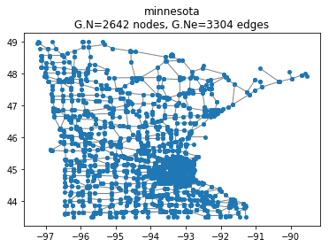
Motivation
Transportation Networks and Diffusion
Minnesota Graph
View data at each traffic intersection in Minnesota
Analyze the network the data and their interaction

Slide 5
Current Wavelet GSP Methods
Spectral Graph Wavelet Transform (Hammond 2011)
Haar Graph Laplacian Eigen Transform (Irion, Saito 2014)
Diffusion Wavelets (Coiffman 2006 )

Slide 6
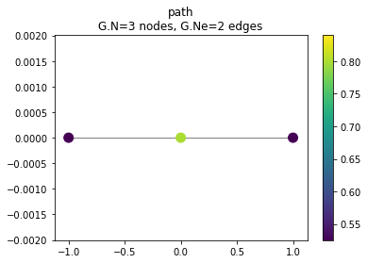



Probabilistic Wavelet Block Thresholding for Graph Signal Processing (GSP)
Step 1: Generate wavelet coefficients
Use any GSP wavelet like transform
Graph Adjacency > Laplacian > Eigen Decomposition > Apply Wavelet operator
Example Using P-3
P-3 Original
A and L
Eigen Decomposition of L
Adjacency
Laplacian

Slide 7

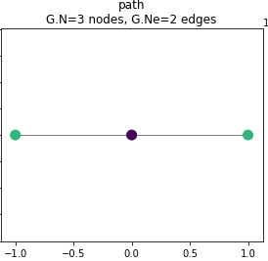
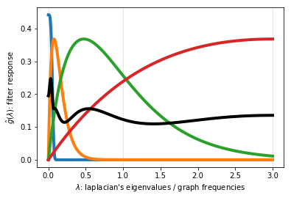
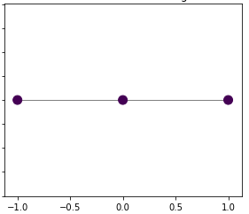
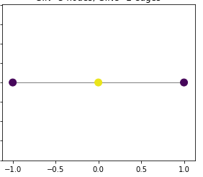
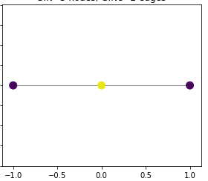
Probabilistic Wavelet Block Thresholding for Graph Signal Processing (GSP)
Step 1: Generate wavelet coefficients
Use any GSP wavelet like transform
Graph Adjacency > Laplacian > Eigen Decomposition > Apply Wavelet operator,
Example Using P-3
Wavelet Filter Bank
Wavelet Coefficients (A1, D1, D2, D3)

Slide 8
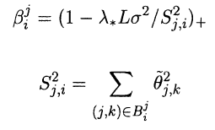
Probabilistic Wavelet Block Thresholding for Graph Signal Processing (GSP)
Step 2: Apply Probabilistic Block Thresholding to Wavelet Coefficients
Bipartition graph wavelet coefficients into blocks of log(n) using the Hidden Markov Viterbi Algorithm
Determines the hidden state for each wavelet observation
Will add theory from (Cai 1999), (Crouse 1998), (Ortega 2018), and (various work from N. Saito) , (DI Shuman 2013)
Threshold Using NeighBlock (Cai 2001)
λ =2/3 log (n)
σ of the signal
ϴ_j,k is the
wavelet coeff
at level j position k

Slide 9
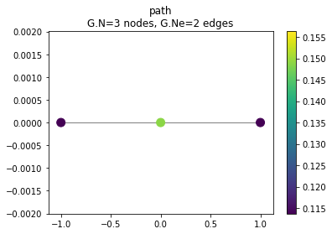
Probabilistic Wavelet Block Thresholding for Graph Signal Processing (GSP)
Step 3: Reconstruct the Signal
Tight Frame: The sum of the psi_j^2 need to be constant equal to one (tight frame property). (de Loynes)

Slide 10
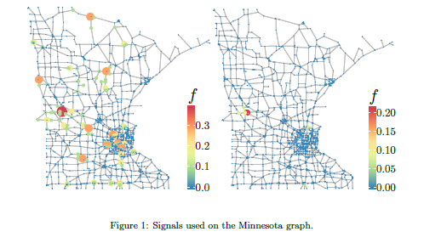
Case Study 1: Minnesota Road Map
(De Loynes 2020) adds Gaussian noise to a random signal on the Minnesota Graph Network
Minnesota with Noise
Minnesota Denoised

Slide 11
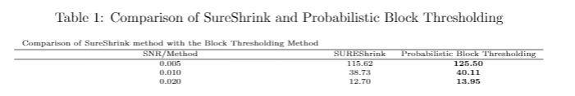
Case Study 1: Minnesota Road Map
Probabilistic Block Thresholding Outperforms only current Thresholding method

Slide 12
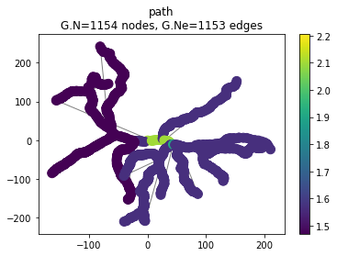
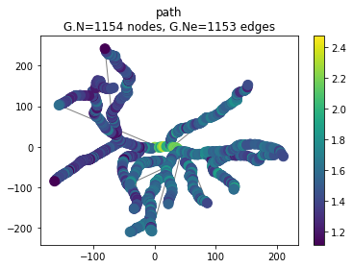
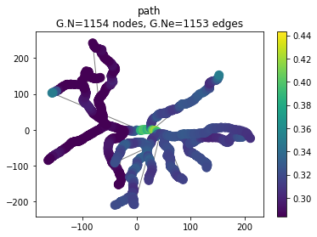
Case Study 2: Rat Ganglion Cell (IP)
(Coombs 2006) measured the widths at different areas of the mouse retinal ganglion cell
Compare Probabilistic Block Thresholding with Best Basis technique (Irion 2014)
Original
Noisy 20 dB
Denoised

Slide 13
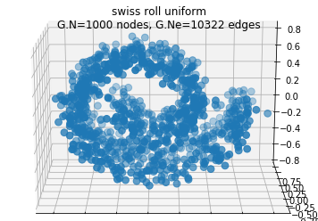
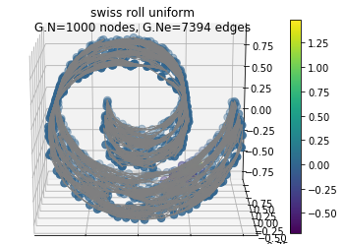
Case Study 3: Manifold Denoising
Deutsch 2016 attempt to predict a manifold from a point cloud using a SGWT prediction scheme

Slide 14
Questions?

Slide 15
References
Deutsch, S., Ortega, A. and Medioni, G., 2016, March. Manifold denoising based on spectral graph wavelets. In 2016 IEEE International Conference on Acoustics, Speech and Signal Processing (ICASSP) (pp. 4673-4677). IEEE.
Hammond, D.K., Vandergheynst, P. and Gribonval, R., 2019. The spectral graph wavelet transform: Fundamental theory and fast computation. In Vertex-Frequency Analysis of Graph Signals (pp. 141-175). Springer, Cham.
Cai, T.T. and Silverman, B.W., 2001. Incorporating information on neighbouring coefficients into wavelet estimation. Sankhyā: The Indian Journal of Statistics, Series B, pp.127-148.
Coifman, R.R. and Maggioni, M., 2006. Diffusion wavelets. Applied and Computational Harmonic Analysis, 21(1), pp.53-94.
de Loynes, B., Navarro, F. and Olivier, B., 2021. Data-driven thresholding in denoising with spectral graph wavelet transform. Journal of Computational and Applied Mathematics, 389, p.113319.

